Slide 1
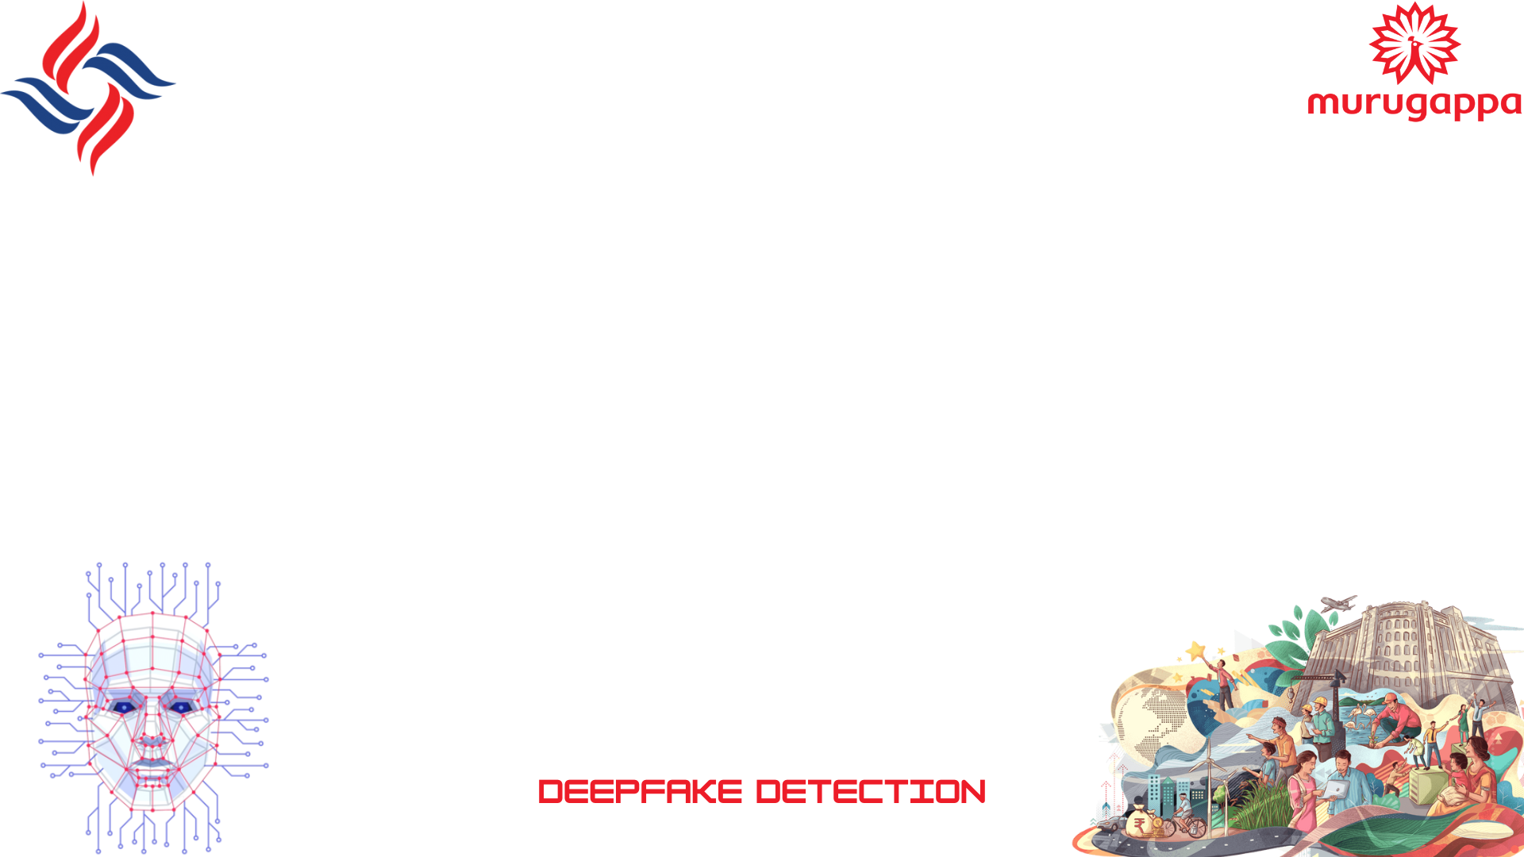

By Abbishek.B
Lakshya.S
Aarthi.G

Slide 2


Problem Statement
To Design and Develop a Deep Learning algorithm to classify the video as deepfake or pristine.

Slide 3
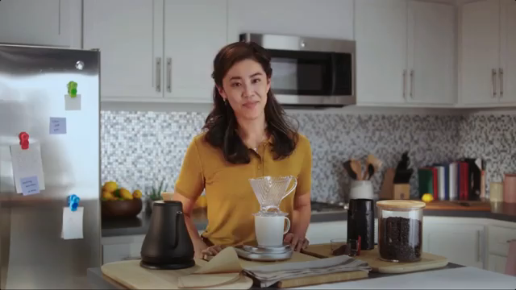
Introduction
Deep fake is a technique for human image synthesis based on artificial intelligence.
Deep fakes are created by combing and superimposing existing images and videos onto source images or videos using a deep learning technique known as generative adversarial network.

Slide 4
Can we detect Deep fakes with naked eyes?

Slide 5
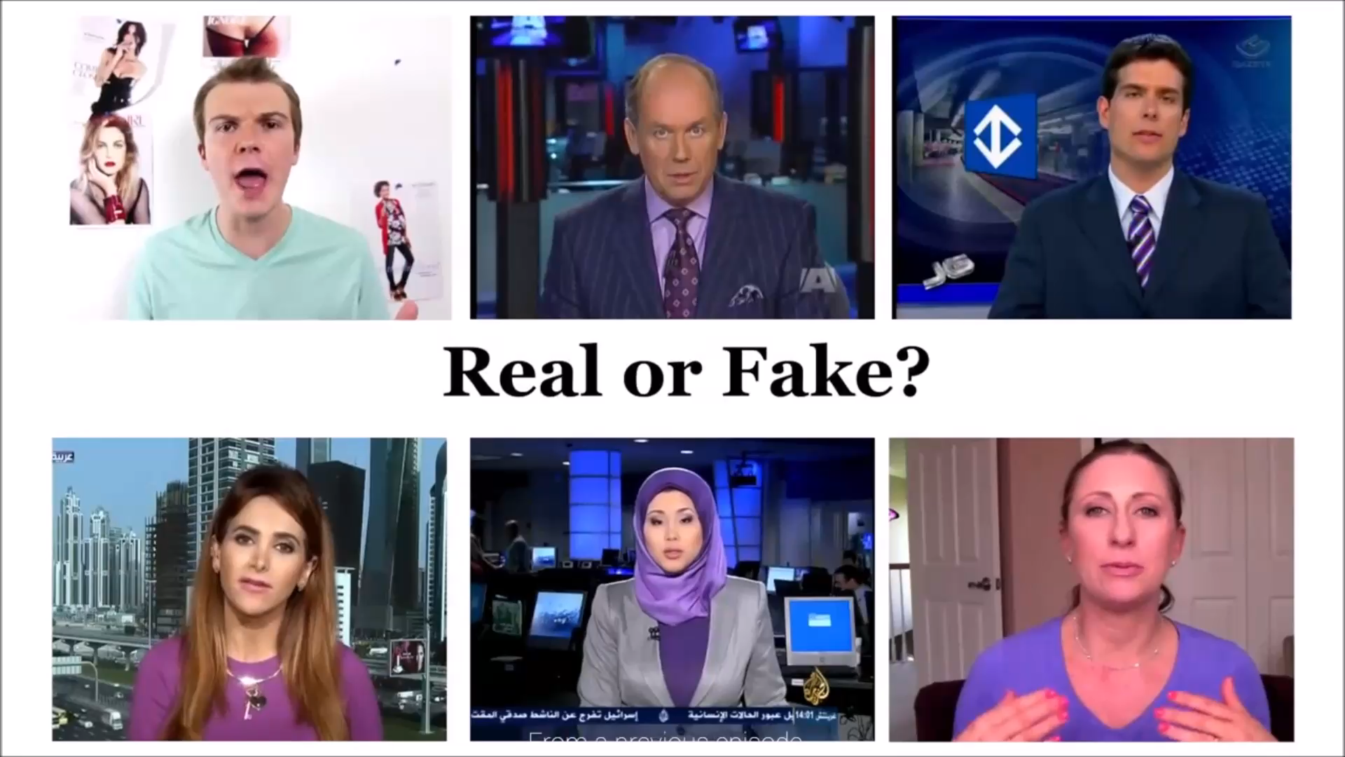

Slide 6
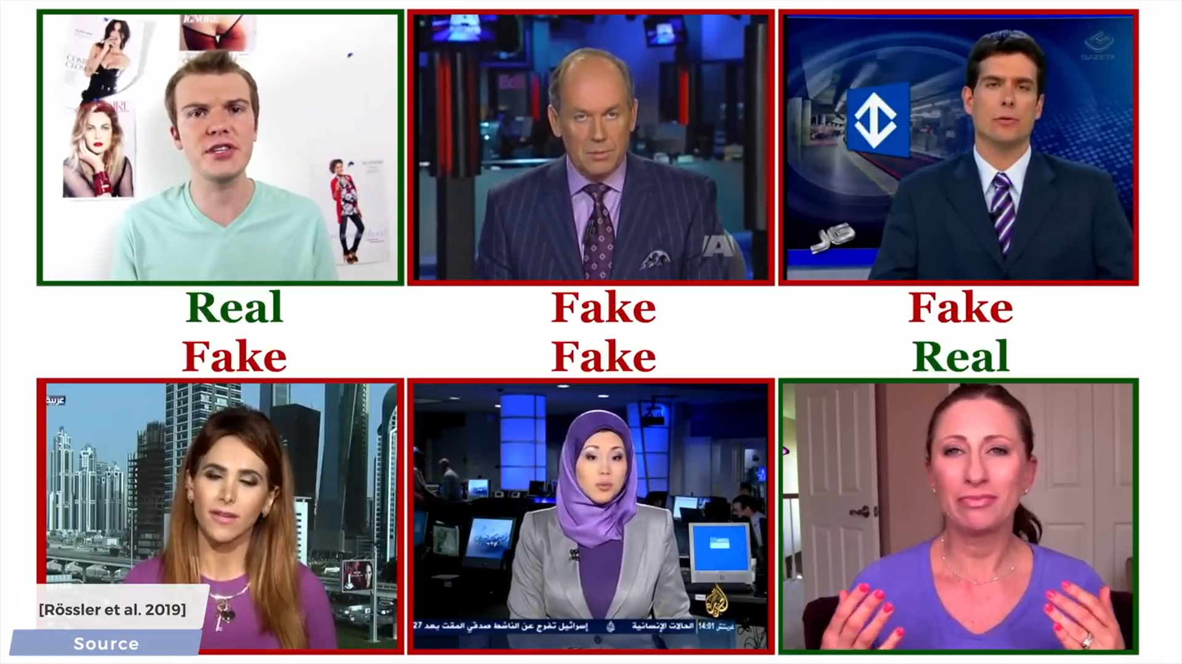

Slide 7
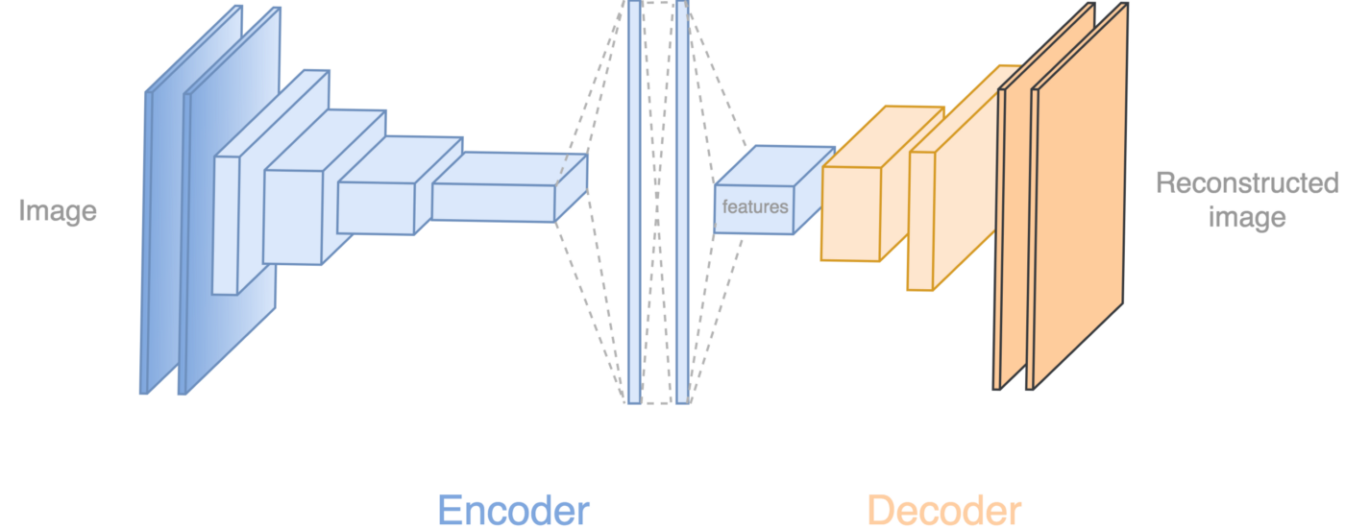
How Deep Fakes Are Created ?
Tools for deep fake creation.
Faceswap
Faceit
DeepFaceLab
Large resolution facemasked

Slide 8
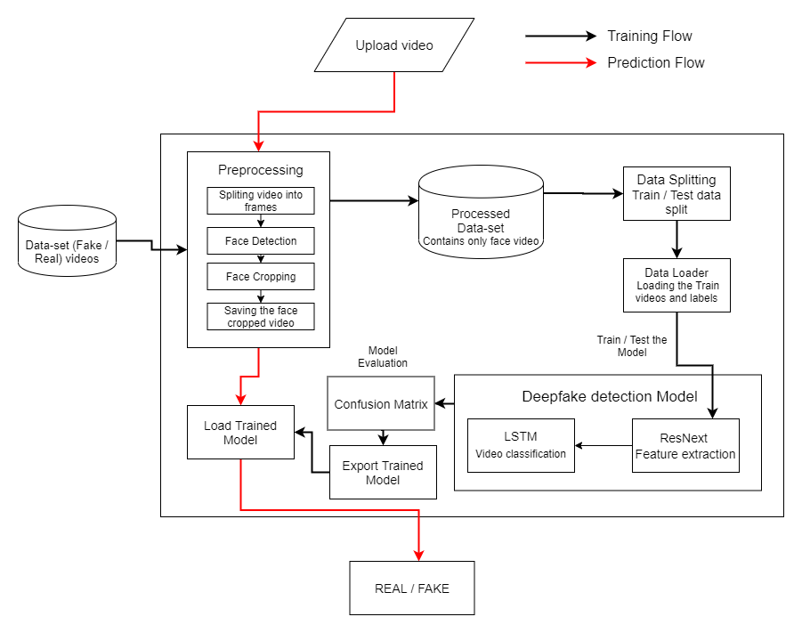

System Architecture

Slide 9
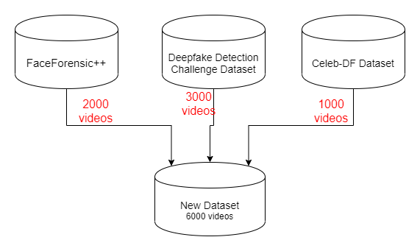
Data-set Exploration

Slide 10
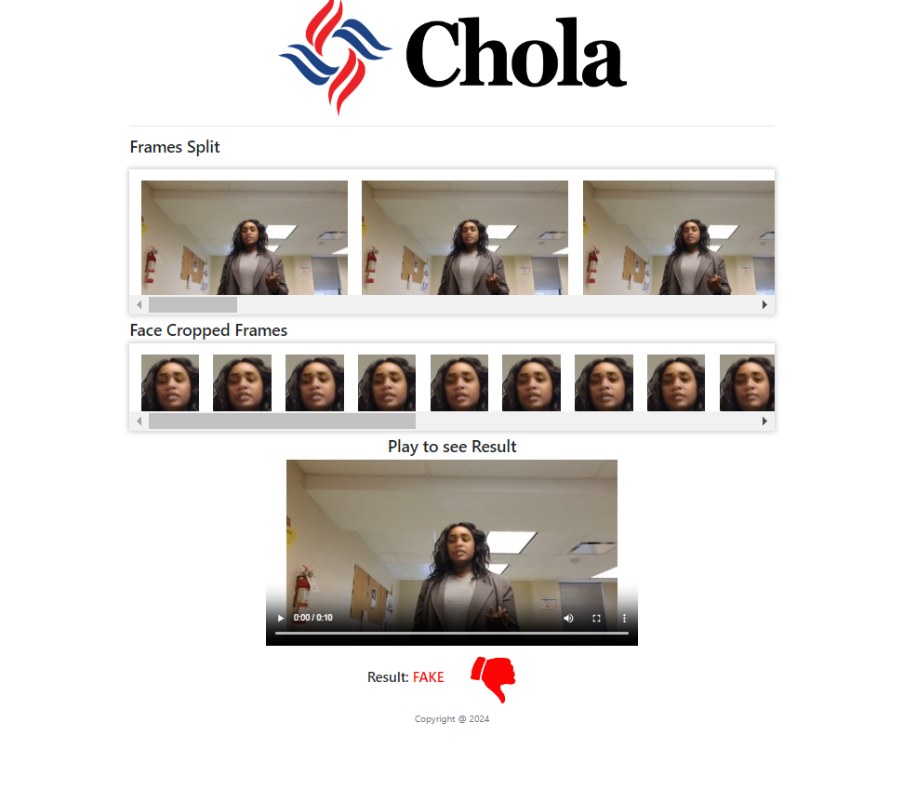

Pre-processing
SPLIT VIDEO INTO FRAMES
FACE DETECTION
5
4
3
2
1
CROPING FACE
CREATING NEW FACE CROPPED VIDEO
SAVING THE FACE CROPPED VIDEO

Slide 11
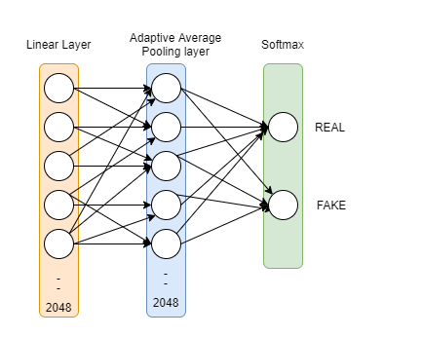
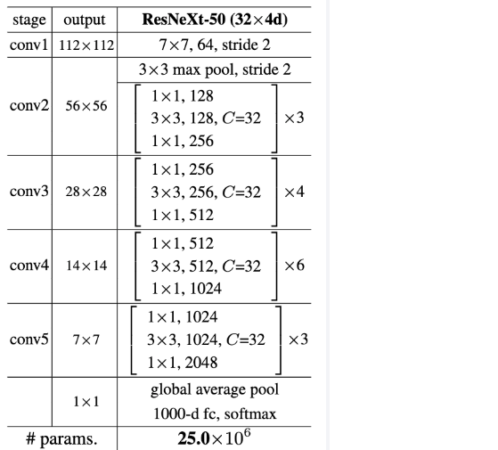

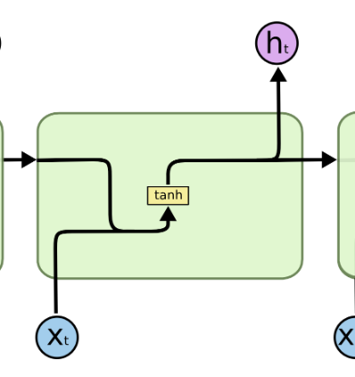
Model Architecture
ResNext-50
1 LSTM layer with 2048 shape input vector and 2048 latent features along with 0.4
chance of dropout and ReLU Activation function
Sequential Layer

Slide 12
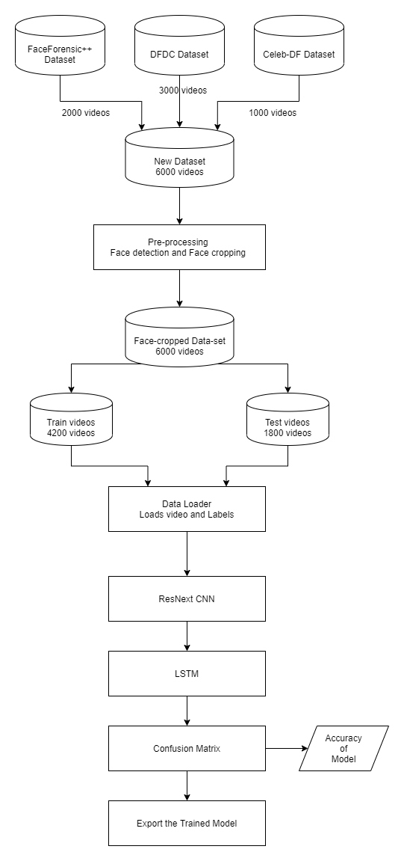
Training Workflow

Slide 13
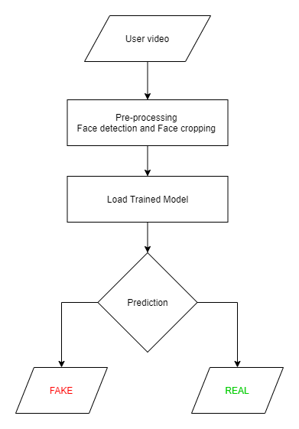
Prediction Workflow

Slide 14














Programming Languages
Python3
JavaScript
Programming Frameworks
PyTorch
Django
Tools and Technologies
IDE
Google
Jupyter Notebook
Visual Studio Code
Cloud Services
Google Cloud Platform
Version Control
Git

